Slide 1
Announcement
Office hours:
M/W 10:30am – noon

Slide 2
UML Activity Diagrams An Introduction

Slide 3
Overview
Purpose:
Describe a task/procedure/process
Components:
Activity - a non-atomic (i.e., decomposable) task
Action - an atomic (i.e., not decomposable) task
Data - inputs to or outputs from actions (and may include state information in square brackets)
Flow - flow of control and flow of data
Notes:
Unified modeling language
UML 1.X made for human only
UML 2.0 for Model Driven Architecture

Slide 4
An Example

Slide 5
Representation and Interpretation
Directed Graph:
Nodes/Vertexes - represent actions or objects
Edges/Arcs/Links - represent control flows and/or data flows
Tokens:
Produced and consumed by nodes (though not represented on the diagram)
Flow instantaneously along edges
Execution:
An action node begins executing when tokens are available on all incoming edges
When an action node begins execution it consumes all incoming tokens
While/after an action node executes it produces outgoing tokens

Slide 6
Symbology
Activities:
Actions:
Objects/Classes/Data:
Flows:

Slide 7
An Example

Slide 8
Additional Elements
Initial Node:
Final Node:
Decision Node:
One incoming edge
One or more outgoing edges
Outgoing edges can have a Boolean guard
Merge Node:
One or more incoming edges
One outgoing edge

Slide 9
An Example Revisited

Slide 10
Why Use Merge Nodes?
Compare the Following Two Activities:
An action does NOT start until the tokens on all of its incoming edges have arrived.
Decision/Merge nodes do NOT consume incoming token, but pass it along.
While actions consume incoming token and produce a new one after execution.

Slide 11
Still More Elements
Pin:
A terminator for data flows into (input pins) or out of (output pins) an action node
Activity Parameter:
An object node on the boundary of an activity
Contains the name of a particular object and the name of its type
Syntax: name:type

Slide 12
A Larger Example
Courtesy of Introduction to Software Engineering and Design (Fox, 2006)

Slide 13
The Larger Example with Object/Data Nodes

Slide 14
Sequential and Parallel Actions
Fork Node:
Splits a single (incoming) flow into multiple concurrent/parallel (outgoing) flows
Join Node:
Synchronizes multiple (incoming) flows into a single (outgoing) flow

Slide 15
An Example with Parallel Actions

Slide 16
Compare the Following Activity Diagrams

Slide 17
Abstraction and Sub-Activities
Abstraction in Activity Diagrams:
As with any model, a decision must be made about how much detail to include
Associating an Activity with an Action:
It's possible to indicate that a sub-activity exists for an action using the following notation:

Slide 18
In-class Activity

Slide 19
Exercises
1. Actions and activities are the same. (F)
2. There can be several activity final nodes in a diagram. (T)
3. There can be several initial nodes in a diagram. (T)
4. A decision node always has two branches. (F)
5. In general, there are as many merge nodes as decision nodes in a diagram. (T)

Slide 20
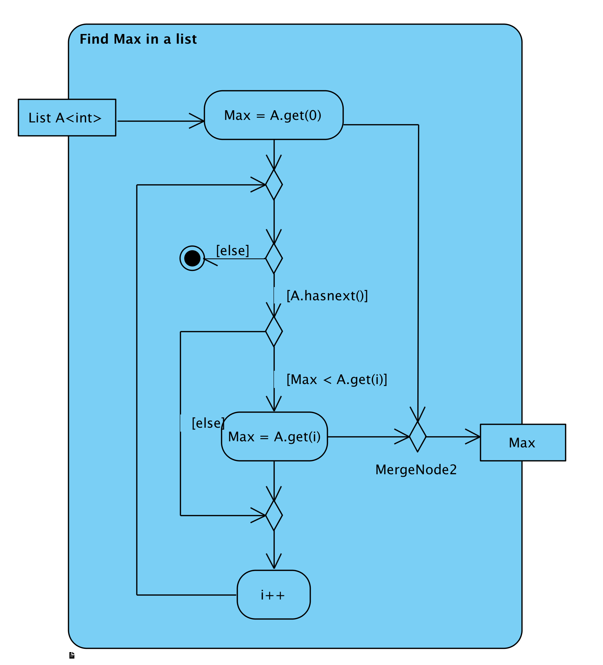
Act00-Activity Diagrams
Draw an activity diagram describing an algorithm for finding the maximum value in a list. The input is the list, and output is the maximum value.

Slide 21
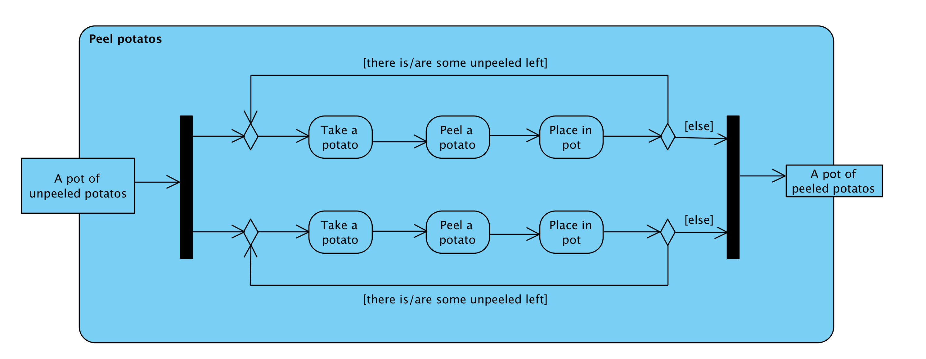
Draw an activity diagram describing two people peeling a pot of potatoes. Note that two people do this in parallel and they stop when all the potatoes are peeled.

Slide 22
Practice
Draw an activity diagram for submitting a HW in Canvas.

